Slide 1

Car number plate recognition
Done by : Rajeshwaran S
(Cse-c III Year)

Slide 2

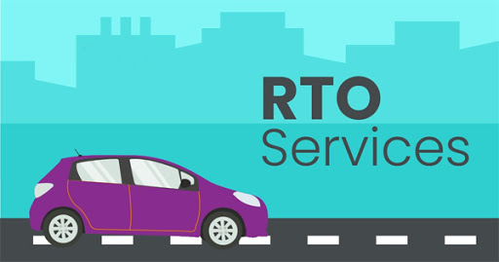
abstract
LPR (License Plate Recognition) is an image-processing technology used to identify vehicles by their license plates. This technology is used in various security and traffic applications, such as the access-control system.
It helps to finding the number plates by police and also helps for RTO.

Slide 3

methodology
Rapid API
Get data in Html page
Paste the Image URL of the image
Predict the data
Test and Validate the data
Displays the statistics in Percentage

Slide 4
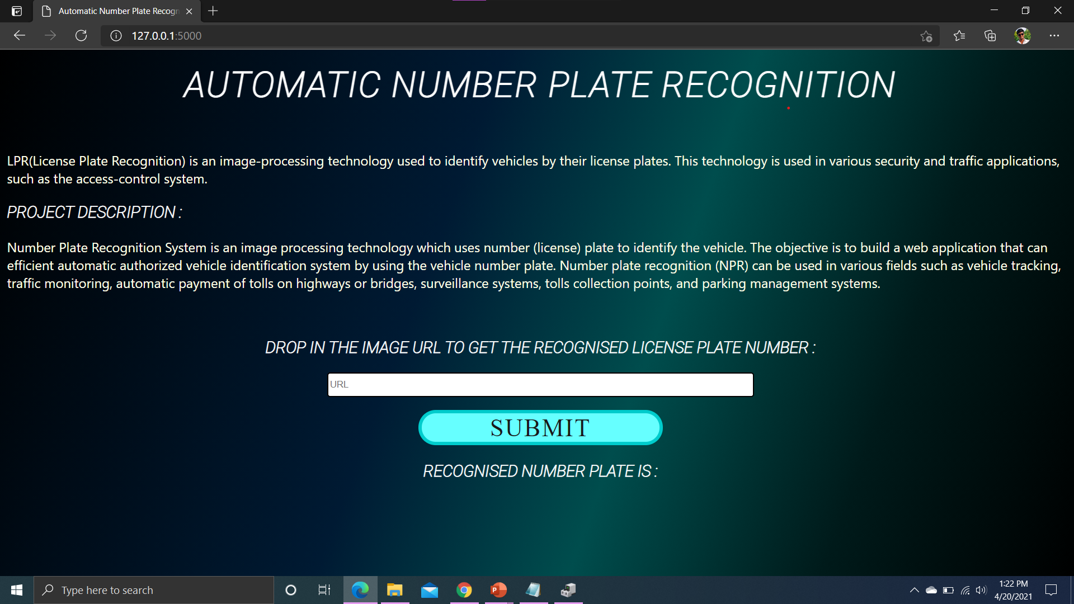
Screenshot of our project
It helps to understand how the project is working upon the data
It is actually working upon the image URL and image recognition of the given dataset
The final output shows the data in the percentage of the match result in the bottom of the web page.

Slide 5

Statistics followed
It matches the nearest matches to the dataset to gain the knowledge about the vehicle number and owner of the vehicle.
It also used predicts the anonymous number were used to committing crimes in our day to day life
In order to avoid the those thinks, we recognize all the details of the vehicle
Matches only the nearest and exactly equal to corresponding owner of the vehicle
It shows the percentage of the vehicle in the exact matches

Slide 6
Merits:
It reduces the crime rate of the day to day life
It reduces the vehicle theft
It can easily predict the number plates while the vehicle struck in the accident
It reduces the insurance and fc fraud in RTO offices, In case it happens, it is easily identified
It can provides the large datasets for the number plates and it returns the maximum accuracy ratio in the overall success match
It provides wide range of countries number plate and their number format of the number plate of the each region of the country.

Slide 7
Demerits:
It induces anonymous person or hacker get the information about the vehicle may possible, it needs some deep encryption and decryption on the user data.
It should gives the guidelines and policy to use this system, keep always authenticated person can take this system
It may be possible in Dos effect on this system, each and every time fix the bugs in this application.
It should take more cost while maintaining this project

Slide 8
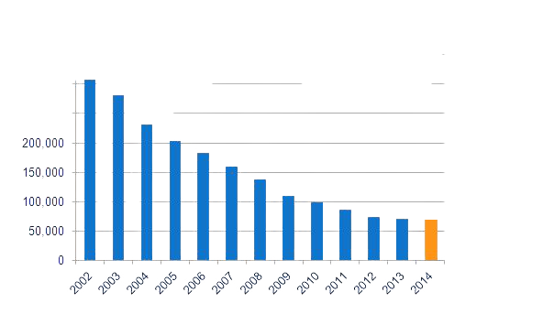
Future Implements:
In the important ceremony, VIP guest of the car must identified and allowed only if found the exact means
It should be prohibited to use anonymous vehicle can be encountered and reduce daily life crime rates
It may be possible in Dos effect on this system, each and every time fix the bugs in this application.
Here is my project link: https://github.com/Raja1807/LearnTechIndia18/tree/main/NPR

Slide 9

Thank you for !!the opportunity!! Any Queries?

